Slide 1

ACCA-X Building High Quality Courses

Slide 2
Why did ACCA develop ACCA-X?
To drive and support demand for the ACCA qualification
Continue ACCA’s innovative approach in ensuring relevant solutions for our stakeholders
Realise opportunities in changes in the way people learn

Slide 3
Challenge the Status Quo
Existing distance learning provision
Diagnostic questions
Teaching is through tutor videos/pdfs of textbook.
Additional tutor/personal advisor support.
Online classroom/ Classroom Live
Expensive (£200 + for F1/2/3)

Slide 4
Does ACCA-X provide the solution?
ACCA-X aims
are:
In practice:
affordable, high quality and relevant.
continuously improve the student experience and success
increase the number of members and students
financially sustainable
Quality: edX say it’s the most content rich course they have
Affordability: WP1 courses are free, WP2 courses are $89 where other distance learning can be £200+
43,000 students enrolled on WP1
The quality makes the payment structure very affordable in comparison to the competitor products
Students say: they understand and retain the concepts, its helping them prepare for exams

Slide 5
ACCA-X: What have we achieved?
Achievement | Date
WP1 courses launched | 28th July 2015
42,836 students (29,502 Introductory 13,334 Intermediate) | 4th August 2015
1,300 posts on course discussion boards | 17th August 2015
Week 4 of WP1 courses underway
WP2 enrolment opened | 21st July 2015
WP2 storyboards final sign off | 24th July 2015
22,566 Facebook likes for WP2 enrolment | 17th August 2015

Slide 6

Impact on Students
What students said about training provision
I was hectic because here you don't have any group members to discuss anything with them if you don't understand something especially where some of us working. Ghana
Lack of assurance that I study up to date syllabus. Russia
The only text book accessible here is BBP, BBP book is very detail and bulk it is not easily understandable. Ethiopia
Difficulty in understanding certain concepts without the help of an experienced knowledgeable person. Uganda
buying all the necessary materials is a bit difficult. Uganda

Slide 7
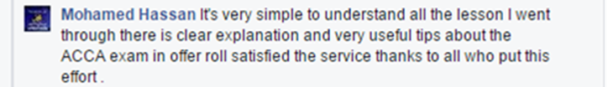
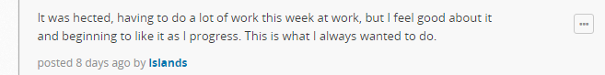
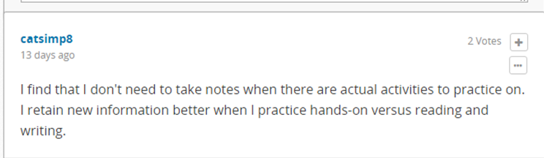
What students say about ACCA-X
On Facebook
On ACCA-X courses

Slide 8
How did we do it?
Epigeum Team
Epigeum Process
Pedagogy of course development
Pedagogy of online tutoring

Slide 9
What is pedagogy?
Educational theory – how best to teach (andragogy)
Blooms taxonomy
Domains of learning
Cognitive (mental skills – knowledge)
Affective (emotional – attitude)
Psychomotor (skills – doing)
FIA – Cognitive domain
Knowledge
Comprehension
Application
Analysis
Synthesis
Evaluation
Increasing level of difficulty

Slide 10
ACCA’s pedagogy.
How we apply pedagogical theory in ACCA-X
Blooms taxonomy - ACCA consolidate Bloom’s 6 levels into 3 ascending levels of cognitive difficulty.
1. Knowledge and comprehension
2. Application and analysis
3. Synthesis and evaluation
Fundamentals = Knowledge (mostly level 1) and Skills modules (mostly Level 2)
Professional = Essentials and Options (Level 3 but also some level 1&2 as new concepts will be introduced)

Slide 11
ACCA-X pedagogical structure.
Learning outcomes – what do we want the students to learn?
Set by the ACCA Syllabus.
Students should be told what level and how much study is required to achieve the syllabus aims – should know how deeply they will be examined in any given area
Teaching strategies
Direct instruction: Teacher-directed and facilitated instruction. Introduction to topics and step-by-step processes. Text and presentational activities
Experiential learning Emphasis is on the process of learning and active learning. Interactive activities
Indirect instruction: Teacher-facilitated but generally student-centred. Discussion forums

Slide 12
Storyboard pedagogy
Structure of the course
Course Orientation
Weekly introduction (LOs and overview)
Lessons and units (PEET)
End of week summary
AYL questions
End of week questions
End of course summary
Practice Tests
Teaching Features
Icons, help button, screen times, glossary, pods,
Authors use these features to create courses that will appeal to people with different learning styles, but that also suits the material being taught – can’t be prescribed, relies on the creativity, experience and talent of the author (and editor)

Slide 13
Storyboard Development: roles
PM – objectives/timelines/pedagogical framework development/templates/recruitment and management of project team
Author – content creation
Tech checker – technically correct/covers syllabus
Editor – make and/or suggest changes to a piece that will improve its clarity, impact, flow, meaning, and readability.
Assistant editor – in-house style standards. Checks facts
Proofreader – checks and corrects grammar, spelling, and punctuation, cross references and continuity
Examiner – checks if the content teach students in a way that will enable them to pass the exam – terminology – syllabus interpretation – depth and breadth of coverage – theories/methods used
ACCA reviewer – engaging, high quality eLearning

Slide 14
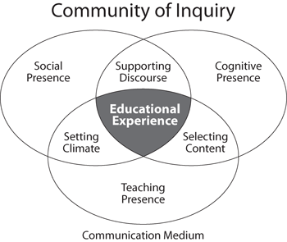
Role of the online tutor
The role of an online tutor – set the tone and lead the discussion
Educational Experience
Social presence – set the tone, create a good learning atmosphere
Cognitive presence – select content and support the debate
Teaching presence – content and atmosphere

Slide 15
Online Tutor in practice
Tutor interactions on ACCA-X
Emails
Welcome and weekly emails
Discussion boards
Student explorations of concepts
Student queries – on content
Community – support and encouragement
Intervention – tutors can correct misconceptions
Wiki (living repository of information for the course)
Interventions during course
Glossary
FAQs
Live sessions

Slide 16
Online Tutor: teaching presence
The design and organisation of course materials and activities, facilitation of learning, and direction and leadership in online courses.
Design and organisation
Welcoming students onto course
Helping students access into
Weekly emails
Facilitation
Scaffolding discussion forums
Modelling engagement
Leadership
Encourage students to lead discussion
Direct feedback
New knowledge (discussion board and wiki)

Slide 17
Online Tutor: Social presence
Social presence: The degree to which participants in online environments feel affectively connected to one another.
A work in progress…possible ideas
Tool? discussion boards not quite enough (social media tab – FB/twitter can be posted through onto edX page…)
Welcome email – include personal info about tutor to set the tone
Icebreaker activity – powerful learning experience discussion/ how their family helps them study , learning strategies that will help each person succeed, previous students do a Q&A to help new students
Badges
Study timetable linked to email calendar/phone reminders (not social but an improvement

Slide 18
Online Tutor: Cognitive presence
Cognitive presence: The extent to which learners are able to construct and confirm meaning in online courses.
3 R’s
Relevance – provoking student curiosity and establishing connections to prior learning or knowledge
Rigour – challenging students to solve problems that are personally meaningful to them
Relationships – designing a learning environment where students work collaboratively together in a community of inquiry.

Slide 19
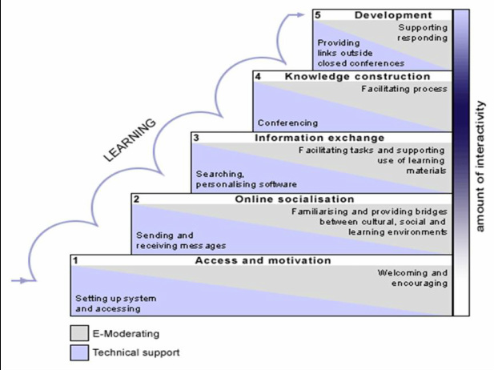
Online tutoring a practical approach.
5 stage model:

