Slide 1
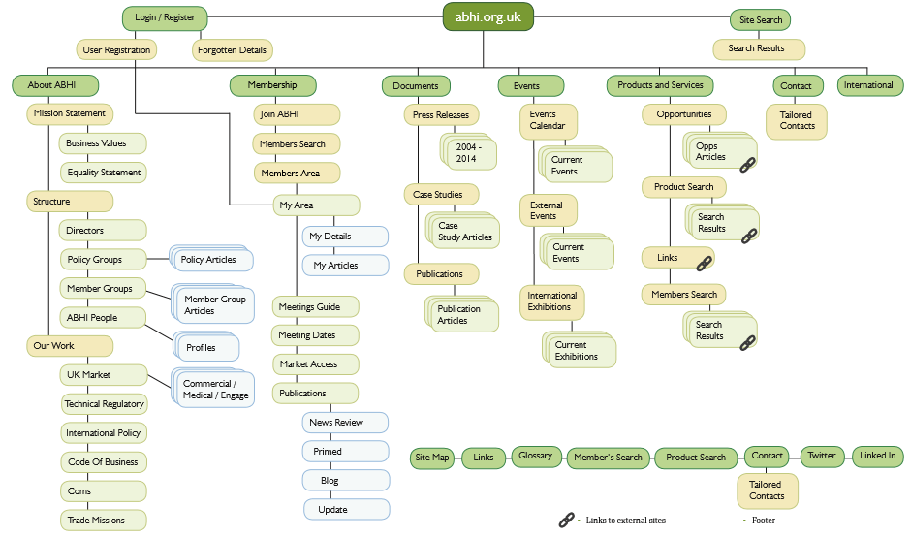
Old Proposed Sitemap
Notes:
Members said the website is:
Too wordy
Useful content mostly buried in members area
Headings are sometimes confusing
Often can not identify anything of interest on the homepage
Some cannot find anything of relevance or help on the entire site
Would love a resources / knowledge hub
Often saved all ABHI emails – as unsure how to access the information via other means

Slide 2
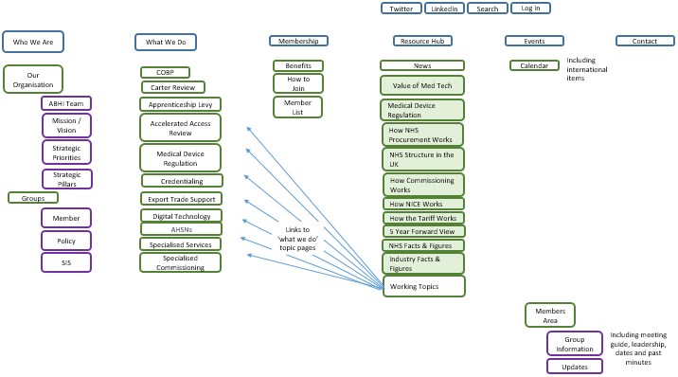
New Sitemap
Notes:
New structure is simpler and addresses issues raised. Easier to navigate, includes sharable resources in variety of formats. From: NHS procurement, NICE, Kings Fund, NHS Confederation. Search by topic or format. Curated more than created.
Homepage amended to include search by profession.
Research Feedback on Content Required:
Need shareable and saveable UK specific content
Infographics (especially for complicated policy changes etc.)
Videos
Ability to collaborate / comment
Would like information / updates from all groups

